Slide 1
Chapter 15 Event-Driven Programming and Animations

Slide 2
Procedural vs. Event-Driven Programming
Procedural programming is executed in procedural/statement order.
In event-driven programming, code is executed upon activation of events.

Slide 3
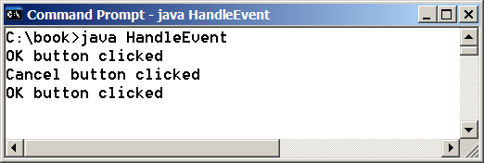
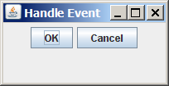
Taste of Event-Driven Programming
The example displays a button in the frame. A message is displayed on the console when a button is clicked.
HandleEvent
Run

Slide 4
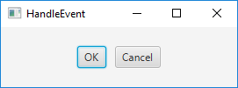
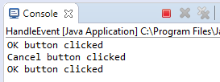
import javafx.application.Application; import javafx.stage.Stage; import javafx.scene.Scene; import javafx.scene.layout.HBox; import javafx.scene.control.Button; import javafx.event.ActionEvent; import javafx.event.EventHandler; import javafx.geometry.Pos;
public class HandleEvent extends Application { public void start(Stage primaryStage) { HBox pane = new HBox(10); Button btOK = new Button("OK"); Button btCancel = new Button("Cancel"); OKHandlerClass handler1 = new OKHandlerClass(); btOK.setOnAction(handler1); CancelHandlerClass handler2 = new CancelHandlerClass(); btCancel.setOnAction(handler2); pane.getChildren().addAll(btOK, btCancel); Scene scene = new Scene(pane); primaryStage.setScene(scene); primaryStage.show(); }…/*main*/} class OKHandlerClass implements EventHandler<ActionEvent> { @Override public void handle(ActionEvent e) { System.out.println("OK button clicked"); }} class CancelHandlerClass implements EventHandler<ActionEvent> { @Override public void handle(ActionEvent e) { System.out.println("Cancel button clicked"); }}

Slide 5
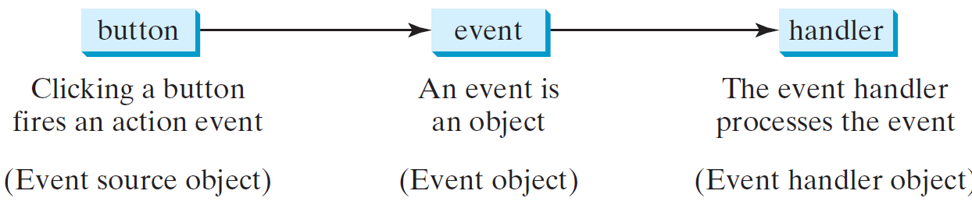
Handling GUI Events
Source object: button
Listener object contains a method for processing the event.
5

Slide 6
Handling GUI Events
The event handler object must be an instance of the EventHandler<T extends Event> interface class OKHandlerClass implements EventHandler<ActionEvent>
The EventHandler object handler must be registered with the event source object using the method source.setOnAction(handler).
The EventHandler<ActionEvent> interface contains the handle(ActionEvent) method for processing the action event. Your handler class must override this method to respond to the event.

Slide 7
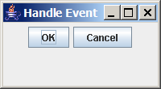
Trace Execution
animation
public class HandleEvent extends Application {
public void start(Stage primaryStage) {
…
OKHandlerClass handler1 = new OKHandlerClass();
btOK.setOnAction(handler1);
CancelHandlerClass handler2 = new CancelHandlerClass();
btCancel.setOnAction(handler2);
…
primaryStage.show(); // Display the stage
}
}
class OKHandlerClass implements EventHandler<ActionEvent> {
@Override
public void handle(ActionEvent e) {
System.out.println("OK button clicked");
}
}
1. Start from the main method to create a window and display it
7

Slide 8
Trace Execution
animation
public class HandleEvent extends Application {
public void start(Stage primaryStage) {
…
OKHandlerClass handler1 = new OKHandlerClass();
btOK.setOnAction(handler1);
CancelHandlerClass handler2 = new CancelHandlerClass();
btCancel.setOnAction(handler2);
…
primaryStage.show(); // Display the stage
}
}
class OKHandlerClass implements EventHandler<ActionEvent> {
@Override
public void handle(ActionEvent e) {
System.out.println("OK button clicked");
}
}
2. Click OK
8

Slide 9
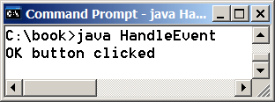
Trace Execution
animation
public class HandleEvent extends Application {
public void start(Stage primaryStage) {
…
OKHandlerClass handler1 = new OKHandlerClass();
btOK.setOnAction(handler1);
CancelHandlerClass handler2 = new CancelHandlerClass();
btCancel.setOnAction(handler2);
…
primaryStage.show(); // Display the stage
}
}
class OKHandlerClass implements EventHandler<ActionEvent> {
@Override
public void handle(ActionEvent e) {
System.out.println("OK button clicked");
}
}
3. Click OK. The JVM invokes the listener’s handle method
9

Slide 10
How can we use it?
For each control (button, combo box, etc.):
define an event handler
construct an instance of event handler
tell the control who its event handler is
Event Handler?
code with response to event
a.k.a. event listener

Slide 11
Java’s Event Handling
When the user interacts with a control (source):
an event object is constructed
the event object is sent to all registered listener objects
the listener object (handler) responds as you defined it to
Event Listeners (Event Handler)
Defined by the application programmer by implementing appropriate interface.

Slide 12
Events
An event can be defined as a type of signal to the program that something has happened.
The event is generated by external user actions such as mouse movements, mouse clicks, or keystrokes.

Slide 13
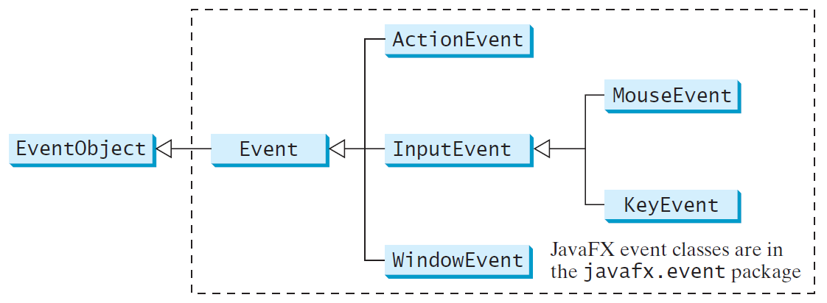
Event Classes

Slide 14
Event Information
An event object contains whatever properties are pertinent to the event:
the source object of the event using the getSource() instance method in the EventObject class.
The subclasses of EventObject deal with special types of events, such as button actions, window events, mouse movements, and keystrokes.

Slide 15
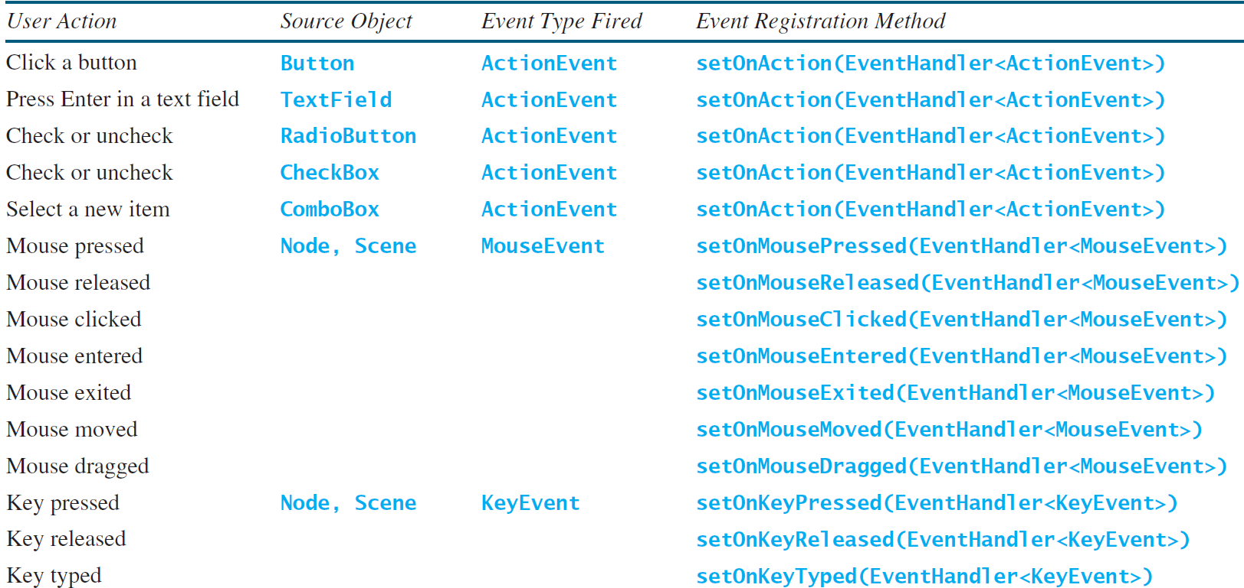
Selected User Actions and Handlers

Slide 16
☑ Check Point
What is an event source object? What is an event object? Describe the relationship between an event source object and an event object.
<--- ANSWER --->
The event source object, also called source object, is the source where an event is fired.
An event object contains the information about the event.
The relationship between a source object and an event is that the event is an object created by the source.

Slide 17
Registering Handlers and Handling Events
A handler is an object that must be registered with an event source object.
It must be an instance of an appropriate event-handling interface.

Slide 18
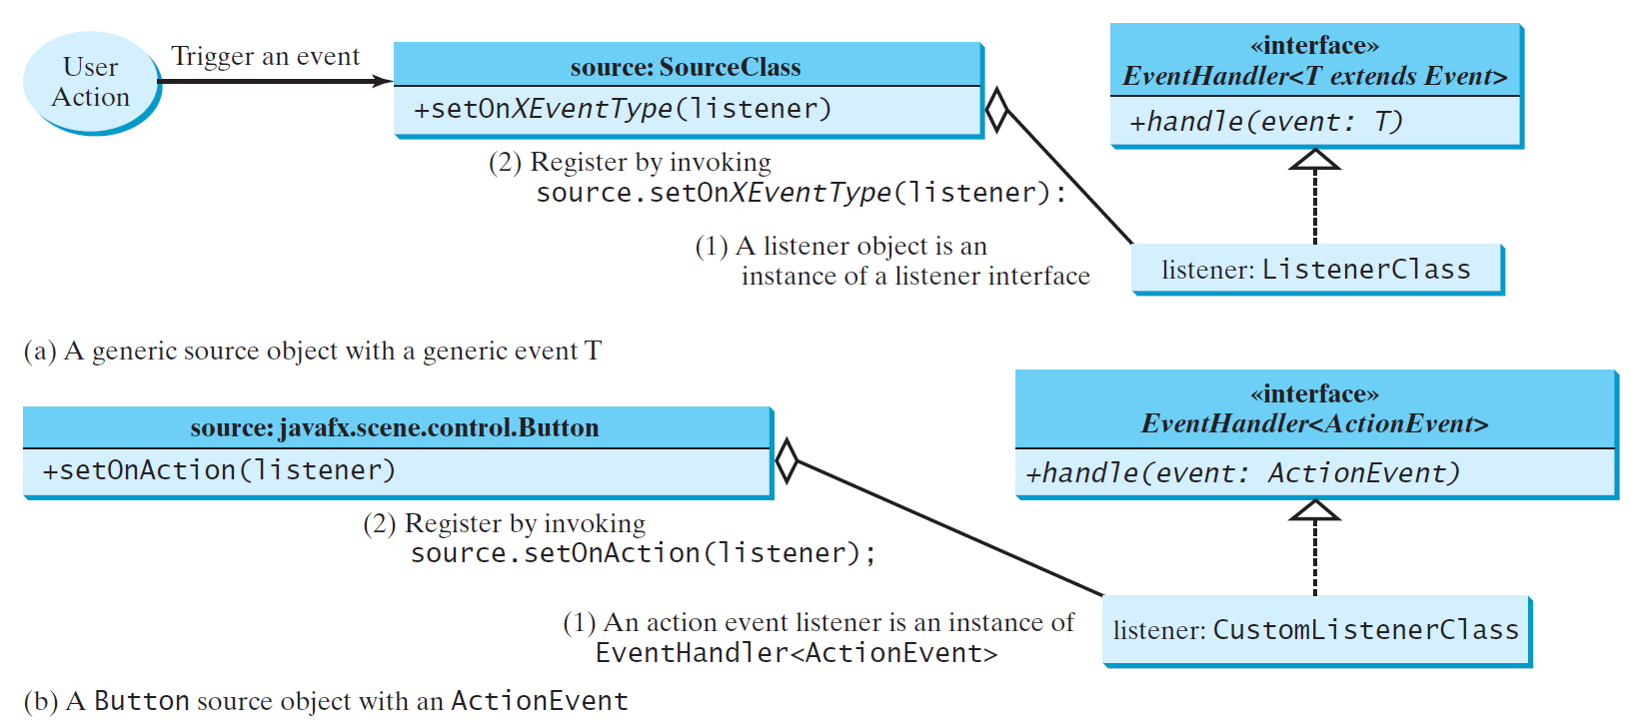
The Delegation Model

Slide 19
The Delegation Model: Example
Button btOK = new Button("OK");
// create handler
OKHandlerClass handler = new OKHandlerClass();
//register handler with the button
btOK.setOnAction(handler);

Slide 20
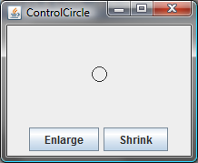
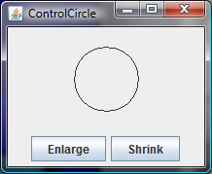
Example: ControlCircle
Now let us consider to write a program that uses two buttons to control the size of a circle.
ControlCircle
Run

Slide 21
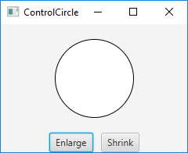
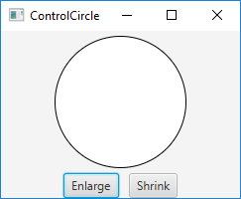
import javafx.application.Application; import javafx.stage.Stage; import javafx.scene.Scene; import javafx.scene.layout.*; import javafx.scene.control.Button; import javafx.event.ActionEvent; import javafx.event.EventHandler; import javafx.geometry.Pos; import javafx.scene.paint.Color; import javafx.scene.shape.Circle;
public class ControlCircle extends Application { private CirclePane circlePane = new CirclePane(); @Override public void start(Stage primaryStage) { HBox hBox = new HBox(); Button btEnlarge = new Button("Enlarge"); Button btShrink = new Button("Shrink"); hBox.getChildren().add(btEnlarge); hBox.getChildren().add(btShrink); btEnlarge.setOnAction(new EnlargeHandler()); BorderPane borderPane = new BorderPane(); borderPane.setCenter(circlePane); borderPane.setBottom(hBox); BorderPane.setAlignment(hBox, Pos.CENTER); Scene scene = new Scene(borderPane, 200, 150); primaryStage.setScene(scene); primaryStage.show(); } 14

Slide 22
//inner class
class EnlargeHandler implements EventHandler<ActionEvent> { @Override public void handle(ActionEvent e) { circlePane.enlarge(); } }
} class CirclePane extends StackPane { private Circle circle = new Circle(50); public CirclePane() { getChildren().add(circle); circle.setStroke(Color.BLACK); circle.setFill(Color.WHITE); } public void enlarge() { circle.setRadius(circle.getRadius() + 2); } public void shrink() { circle.setRadius(circle.getRadius() > 2 ? circle.getRadius() - 2 : circle.getRadius()); } } 15

Slide 23
☑ Check Point
Explain how to register a handler object and how to implement a handler interface.
<--- ANSWER --->
To register a handler object, you invoke the source object's registration method; for example, button.setOnAction(handler) for registering a handler for a button action event. To implement a handler interface, you implement the method defined in the handler interface.

Slide 24
☑ Check Point
What is the handler method for the EventHandler<ActionEvent> interface?
<--- ANSWER --->
The handler method for the EventHandler<T extends Event> interface is
public void handle(T)

Slide 25
☑ Check Point
What is the registration method for a button to register an ActionEvent handler?
<--- ANSWER --->
The method for a button to register an ActionEvent is
button.setOnAction(handler)

Slide 26
Inner Class Listeners
A listener class is designed specifically to create a listener object for a GUI component (e.g., a button).
It will not be shared by other applications.
So, it is appropriate to define the listener class inside the frame class as an inner class.

Slide 27
Inner Classes
Inner class: A class is a member of another class.
Advantages: In some applications, you can use an inner class to make programs simple.
An inner class can reference the data and methods defined in the outer class in which it nests, so you do not need to pass the reference of the outer class to the constructor of the inner class.

Slide 28
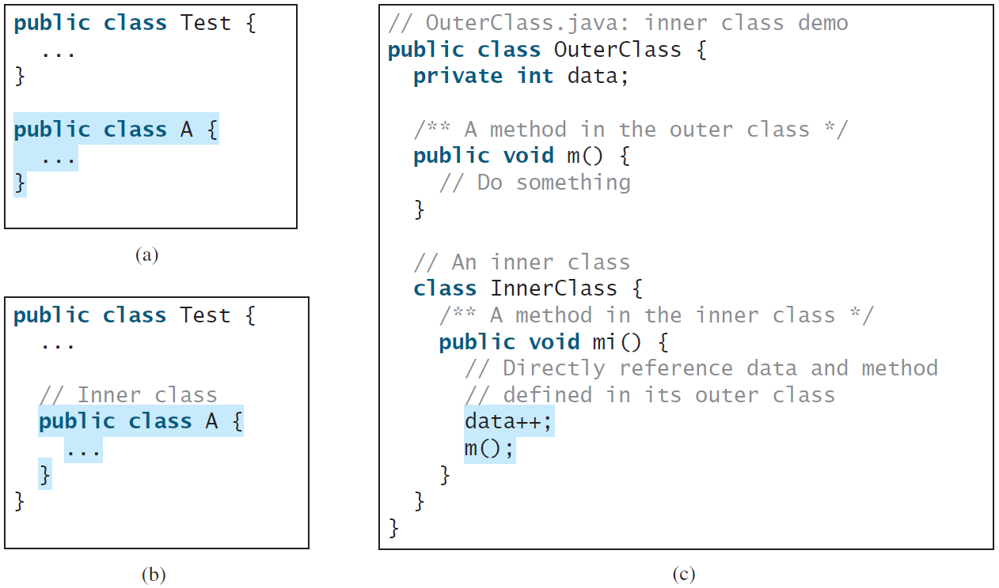
Inner Classes, cont.

Slide 29
Inner Classes (cont.)
Inner classes can make programs simple and concise.
An inner class supports the work of its containing outer class and is compiled into a class named
OuterClassName$InnerClassName.class.
For example, the inner class A in Test is compiled into Test$A.class.
Notes:
-- Another practical use of inner classes is to avoid class-naming conflicts.
-- Two versions of Circle might be defined.
-- You can define them as inner classes to avoid a conflict.

Slide 30
Inner Classes (cont.)
An inner class can be declared public, protected, or private subject to the same visibility rules applied to a member of the class.
An inner class can be declared static.
A static inner class can be accessed using the outer class name.
A static inner class cannot access nonstatic members of the outer class

Slide 31
Inner Classes (cont.)
Objects of an inner class are often created in the outer class. But you can also create an object of an inner class from another class.
If the inner class is nonstatic:
OuterClass outerObject = new OuterClass();
OuterClass.InnerClass innerObject = outerObject.new InnerClass();
If the inner class is static:
OuterClass.InnerClass innerObject = new OuterClass.InnerClass();
Notes:
-- You can also create an object of an inner class from another class.
-- If the inner class is non-static, you must first create an instance of the outer class, then use the following syntax to create an object for the inner class: OuterClass.InnerClass innerObject = outerObject.new InnerClass(); -- If the inner class is static, use the following syntax to create an object for it: OuterClass.InnerClass innerObject = new OuterClass.InnerClass();

Slide 32
Anonymous Inner Classes
Inner class listeners can be shortened using anonymous inner classes: inner classes without a name.
It combines declaring an inner class and creating an instance of the class in one step.
An anonymous inner class is declared as follows:
new SuperClassName/InterfaceName() { // Implement or override methods in superclass/interface // Other methods if necessary }

Slide 33
Anonymous Inner Classes
An anonymous inner class must always extend a superclass or implement an interface, but it cannot have an explicit extends or implements clause.
An anonymous inner class must implement all the abstract methods in the superclass or in the interface.
An anonymous inner class always uses the no-arg constructor from its superclass to create an instance.
If an anonymous inner class implements an interface, the constructor is Object().
An anonymous inner class is compiled into a class named OuterClassName$n.class.
For example, if the outer class Test has two anonymous inner classes, these two classes are compiled into Test$1.class and Test$2.class.

Slide 34
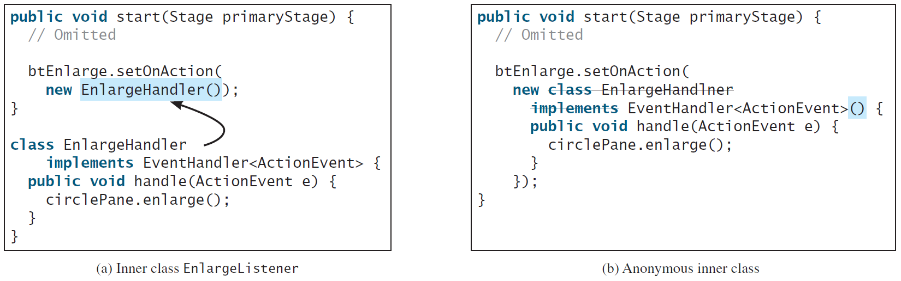
Anonymous Inner Classes (cont.)
AnonymousHandlerDemo
Run
Notes:
- Continue with next 2 slides, then turn back here and click on DEMO CODE. Ask students what this code does.

Slide 35

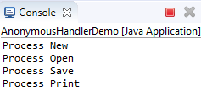
import javafx.application.Application; import javafx.stage.Stage; import javafx.scene.Scene; import javafx.scene.layout.HBox; import javafx.scene.control.Button; import javafx.event.ActionEvent; import javafx.event.EventHandler; import javafx.geometry.Pos; public class AnonymousHandlerDemo extends Application { public void start(Stage primaryStage) { HBox hBox = new HBox(); Button btNew = new Button("New"); Button btOpen = new Button("Open"); Button btSave = new Button("Save"); Button btPrint = new Button("Print");
hBox.getChildren().addAll(btNew, btOpen, btSave, btPrint); // Create and register the handler btNew.setOnAction(new EventHandler<ActionEvent>() { @Override // Override the handle method public void handle(ActionEvent e) { System.out.println("Process New"); } }); btOpen.setOnAction(new EventHandler<ActionEvent>() { @Override // Override the handle method public void handle(ActionEvent e) { System.out.println("Process Open"); } }); 22

Slide 36
btSave.setOnAction(new EventHandler<ActionEvent>() {
@Override // Override the handle method
public void handle(ActionEvent e) {
System.out.println("Process Save");
}
});
btPrint.setOnAction(new EventHandler<ActionEvent>() {
@Override // Override the handle method
public void handle(ActionEvent e) {
System.out.println("Process Print");
}
});
Scene scene = new Scene(hBox, 300, 50); primaryStage.setTitle("AnonymousHandlerDemo"); primaryStage.setScene(scene); primaryStage.show(); } public static void main(String[] args) { launch(args); } }
Notes:
- Go 2 slides back, then click on DEMO CODE. Ask students what this code does.

Slide 37
☑ Check Point
If class A is an inner class in class B, what is the .class file for A? If class B contains two anonymous inner classes, what are the .class file names for these two classes?
<--- ANSWER --->
If class A is an inner class in class B, the .class file for A is B$A.class.
If class B contains two anonymous inner classes, the .class file names for these two classes are B$1 and B$2.

Slide 38
☑ Check Point
What is wrong in the following code?
public class Test extends Application {
public void start(Stage stage) {
Button btOK = new Button("OK");
}
private class Handler implements EventHandler<ActionEvent> {
public void handle(Action e) {
System.out.println(e.getSource());
}
}
}
<--- ANSWER --->
There is no registration for the handler.

Slide 39
☑ Check Point
What is wrong in the following code?
public class Test extends Application {
public void start(Stage stage) {
Button btOK = new Button("OK");
btOK.setOnAction(
new EventHandler<ActionEvent> {
public void handle(ActionEvent e) {
System.out.println(e.getSource());
}
} // Something missing here
}
}
<--- ANSWER --->
Missing ); in Line -2.
Missing () after EventHandler<ActionEvent>().

Slide 40
Simplifying Event Handing Using Lambda Expressions
Lambda expression is a new feature in Java 8.
Lambda expressions can be viewed as an anonymous class with a concise syntax.
For example, the following code in (a) can be greatly simplified using a lambda expression in (b) in three lines.
Notes:
The compiler treats a lambda expression as if it is an object created from an anonymous inner class.
In this case, the compiler understands that the object must be an instance of EventHandler<ActionEvent>.
Since the EventHandler interface defines the handle method with a parameter of the ActionEvent type, the compiler automatically recognizes that e is a parameter of the ActionEvent type, and the statements are for the body of the handle method.
The EventHandler interface contains just one method.

Slide 41
Basic Syntax for a Lambda Expression
The basic syntax for a lambda expression is either
(type1 param1, type2 param2, ...) -> expression
or
(type1 param1, type2 param2, ...) -> { statements; }
The data type for a parameter may be explicitly declared or implicitly inferred by the compiler. The parentheses can be omitted if there is only one parameter without an explicit data type.

Slide 42
Single Abstract Method Interface (SAM)
The statements in the lambda expression is all for that method.
If it contains multiple methods, the compiler will not be able to compile the lambda expression.
So, for the compiler to understand lambda expressions, the interface must contain exactly one abstract method.
Such an interface is known as a functional interface, or a Single Abstract Method (SAM) interface.
LambdaHandlerDemo

Slide 43

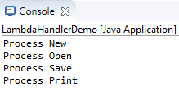
import javafx.application.Application; import javafx.stage.Stage; import javafx.scene.Scene; import javafx.scene.layout.HBox; import javafx.scene.control.Button; import javafx.event.ActionEvent; import javafx.event.EventHandler; import javafx.geometry.Pos; public class LambdaHandlerDemo extends Application { @Override public void start(Stage primaryStage) { // Hold two buttons in an HBox HBox hBox = new HBox(); hBox.setSpacing(10); hBox.setAlignment(Pos.CENTER); Button btNew = new Button("New"); Button btOpen = new Button("Open"); Button btSave = new Button("Save"); Button btPrint = new Button("Print"); hBox.getChildren().addAll(btNew, btOpen, btSave, btPrint); btNew.setOnAction((ActionEvent e) -> {System.out.println("Process New");}); btOpen.setOnAction((e) -> {System.out.println("Process Open");}); btSave.setOnAction(e -> {System.out.println("Process Save");}); btPrint.setOnAction(e -> System.out.println("Process Print")); Scene scene = new Scene(hBox, 300, 50); primaryStage.setScene(scene); primaryStage.show(); } public static void main(String[] args) { launch(args); }
}25
Notes:
You can handle events by defining handler classes using inner classes, anonymous inner classes, or lambda expressions.
We recommend that you use lambda expressions because it produces a shorter, clearer, and cleaner code.

Slide 44
☑ Check Point
What is a lambda expression? What is the benefit of using lambda expressions for event handling? What is the syntax of a lambda expression?
<--- ANSWER --->
Lambda expressions can be viewed as an anonymous class with a concise syntax.
Using lambda expressions can make code concise and easy to read.
The syntax for lambda expressions is:
(type1 para1, …, typen paramn) -> expression;
(type1 para1, …, typen paramn) -> {statements};
() -> expression; or
() -> {statements};

Slide 45
☑ Check Point
What is a functional interface? Why is a functional interface required for a lambda expression?
<--- ANSWER --->
A functional interface is the interface with exactly one method.
A lambda expression works only with a functional interface. For the compiler to understand lambda expressions, the interface must contain exactly one abstract method.

Slide 46
Problem: Loan Calculator
LoanCalculator
Run
Notes:
- Left to PS.

Slide 47
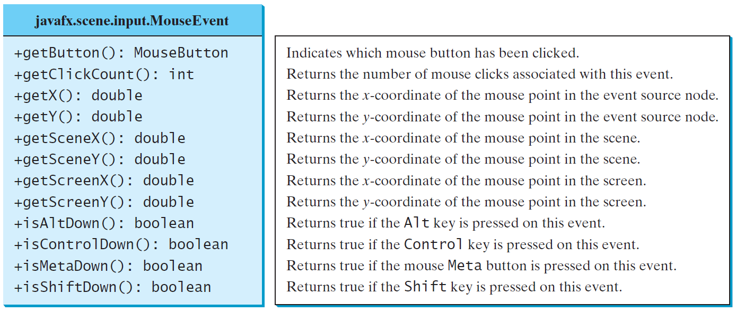
MouseEvent
A MouseEvent is fired whenever a mouse button is pressed, released, clicked, moved, or dragged on a node or a scene.
MouseEventDemo
Run

Slide 48
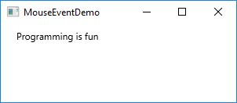
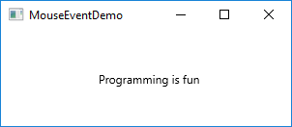
// Move the text with the mouse clicked import javafx.application.Application; import javafx.stage.Stage; import javafx.scene.Scene; import javafx.scene.layout.Pane; import javafx.scene.text.Text;
public class MouseEventDemo extends Application { @Override public void start(Stage primaryStage) { Pane pane = new Pane(); Text text = new Text(20, 20, "Programming is fun"); pane.getChildren().addAll(text); text.setOnMouseDragged(e -> { text.setX(e.getX()); text.setY(e.getY()); }); Scene scene = new Scene(pane, 300, 100); primaryStage.setTitle("MouseEventDemo"); primaryStage.setScene(scene); primaryStage.show(); } public static void main(String[] args) { launch(args); } } 29

Slide 49
☑ Check Point
What method do you use to get the mouse-point position for a mouse event?
<--- ANSWER --->
e.getX() and e.getY()

Slide 50
☑ Check Point
What methods do you use to register a handler for a mouse pressed, released, clicked, entered, exited, moved and dragged event?
<--- ANSWER --->
setOnMouseClicked(handler)
setOnMousePressed(handler)
setOnMouseReleased(handler)
setOnMouseEntered(handler)
setOnMouseExited(handler)
setOnMouseDragged(handler)
setOnMouseMoved(handler)

Slide 51
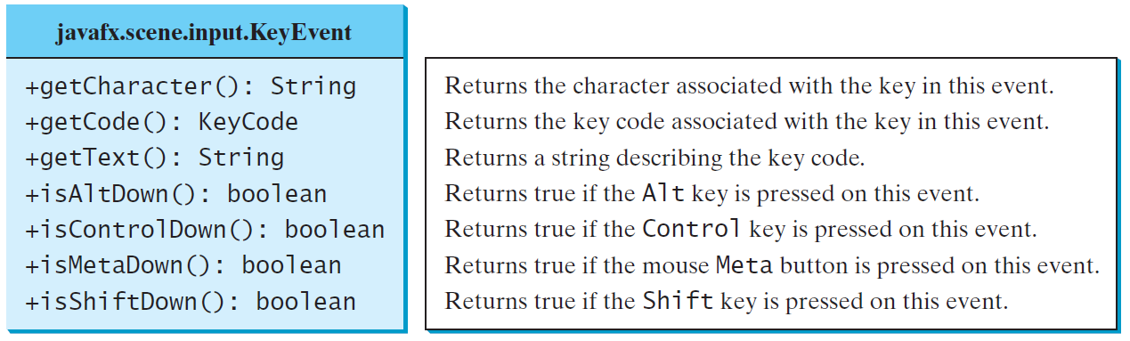
The KeyEvent Class
A KeyEvent is fired whenever a key is pressed, released, or typed on a node or a scene.
KeyEventDemo
Run
Notes:
Every key event has an associated code that is returned by the getCode() method in KeyEvent.
The key codes are constants defined in KeyCode.
For the key-pressed and key-released events,
getCode() returns the value as defined in the table,
getText() returns a string that describes the key code, and
getCharacter() returns an empty string.
For the key-typed event,
getCode() returns UNDEFINED, and
getCharacter() returns the Unicode character or a sequence of characters associated with the key-typed event.

Slide 52
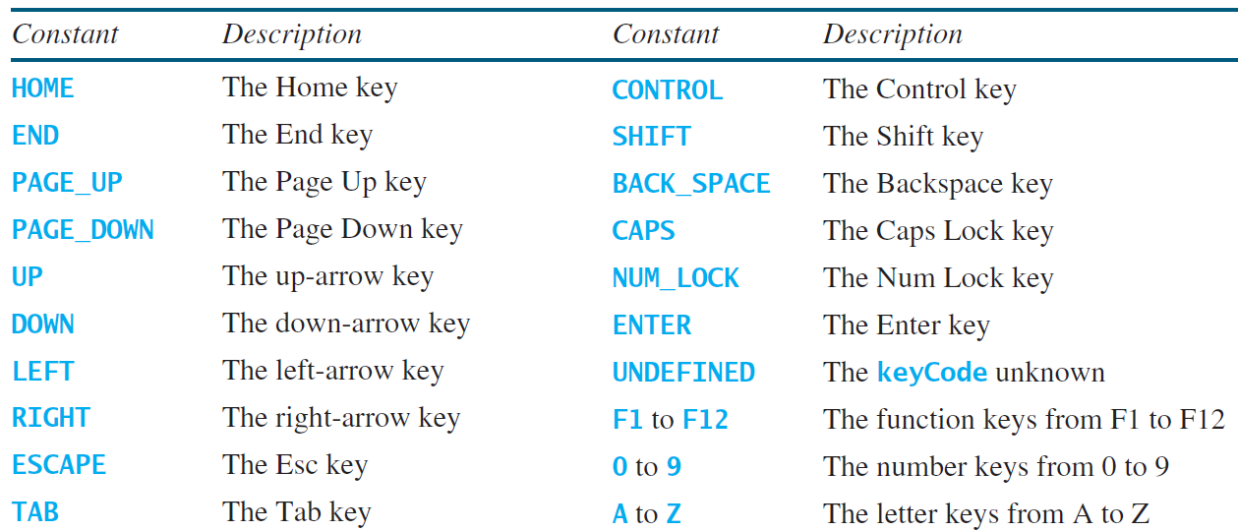
The KeyCode Constants

Slide 53



import javafx.application.Application; import javafx.stage.Stage; import javafx.scene.Scene; import javafx.scene.layout.Pane; import javafx.scene.text.Text;
public class KeyEventDemo extends Application { @Override public void start(Stage primaryStage) { Pane pane = new Pane(); Text text = new Text(20, 20, "A"); text.setFocusTraversable(true); pane.getChildren().add(text); text.setOnKeyPressed(e -> { switch (e.getCode()) { case DOWN: text.setY(text.getY() + 10); break; case UP: text.setY(text.getY() - 10); break; case LEFT: text.setX(text.getX() - 10); break; case RIGHT: text.setX(text.getX() + 10); break; default: if (Character.isLetterOrDigit(e.getText().charAt(0))) text.setText(e.getText()); } }); Scene scene = new Scene(pane); primaryStage.setTitle("KeyEventDemo"); primaryStage.setScene(scene); primaryStage.show();
} …/*main*/}
Notes:
Only a focused node can receive KeyEvent.
Invoking setFocusTraversable(true) enables text to receive key input.

Slide 54
Example: Control Circle with Mouse and Key
ControlCircleWithMouseAndKey
Run

Slide 55
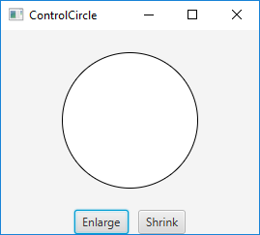
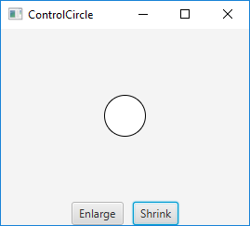
// import …
public class ControlCircleWithMouseAndKey extends Application { private CirclePane circlePane = new CirclePane(); @Override public void start(Stage primaryStage) { HBox hBox = new HBox(); hBox.setSpacing(10); hBox.setAlignment(Pos.CENTER); Button btEnlarge = new Button("Enlarge"); Button btShrink = new Button("Shrink"); hBox.getChildren().add(btEnlarge); hBox.getChildren().add(btShrink); btEnlarge.setOnAction(e -> circlePane.enlarge()); btShrink.setOnAction(e -> circlePane.shrink()); circlePane.setOnMouseClicked(e -> { if (e.getButton() == MouseButton.PRIMARY) { circlePane.enlarge(); } else if (e.getButton() == MouseButton.SECONDARY) { circlePane.shrink(); } });
circlePane.setFocusTraversable(true);
circlePane.setOnKeyPressed(e -> { if (e.getCode() == KeyCode.U) { circlePane.enlarge(); } else if (e.getCode() == KeyCode.D) { circlePane.shrink(); } }); BorderPane borderPane = new BorderPane(); borderPane.setCenter(circlePane); borderPane.setBottom(hBox); BorderPane.setAlignment(hBox, Pos.CENTER); Scene scene = new Scene(borderPane, 200, 150);
…
The circle will enlarge by
clicking Enlarge button,
Mouse left click,
Keyboard U press.
The circle will shrink by
clicking Shrink button,
Mouse right click,
Keyboard D press.

Slide 56
☑ Check Point
What methods do you use to register handlers for key pressed, key released, and key typed events? In which classes are these methods defined?
<--- ANSWER --->
setOnKeyPressed(handler)
setOnKeyReleased(handler)
setOnKeyTyped(handler)
These methods are defined in the Node and Scene classes.

Slide 57
Listeners for Observable Objects
You can add a listener to process a value change in an observable object.
An instance of Observable is known as an observable object, which contains the addListener(InvalidationListener listener) method for adding a listener.
Once the value is changed in the property, a listener is notified.
The listener class should implement the InvalidationListener interface, which uses the invalidated(Observable o) method to handle the property value change. Every binding property is an instance of Observable.
ObservablePropertyDemo
Run
DisplayResizableClock
Run
Notes:
Click on ObservablePropertyDemo and explain the code
Click on DisplayResizableClock and explain the code

Slide 58
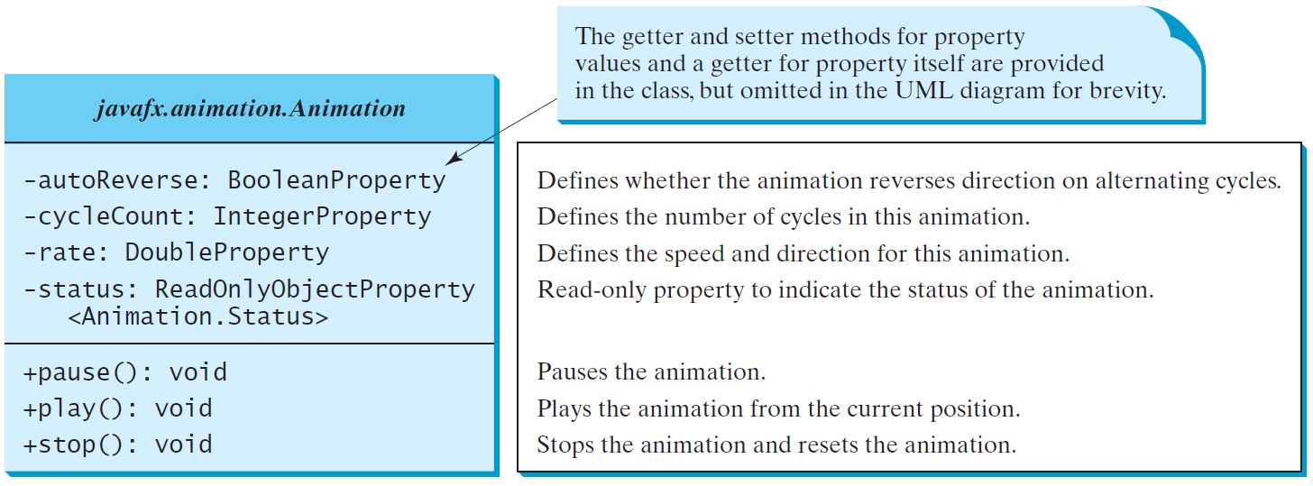
Animation
JavaFX provides the Animation class with the core functionality for all animations.
Notes:
You can use the constant Timeline.INDEFINITE to indicate an indefinite number of cycles.
status -> Animation.Status.PAUSED, Animation.Status.RUNNING, Animation.Status.STOPPED

Slide 59
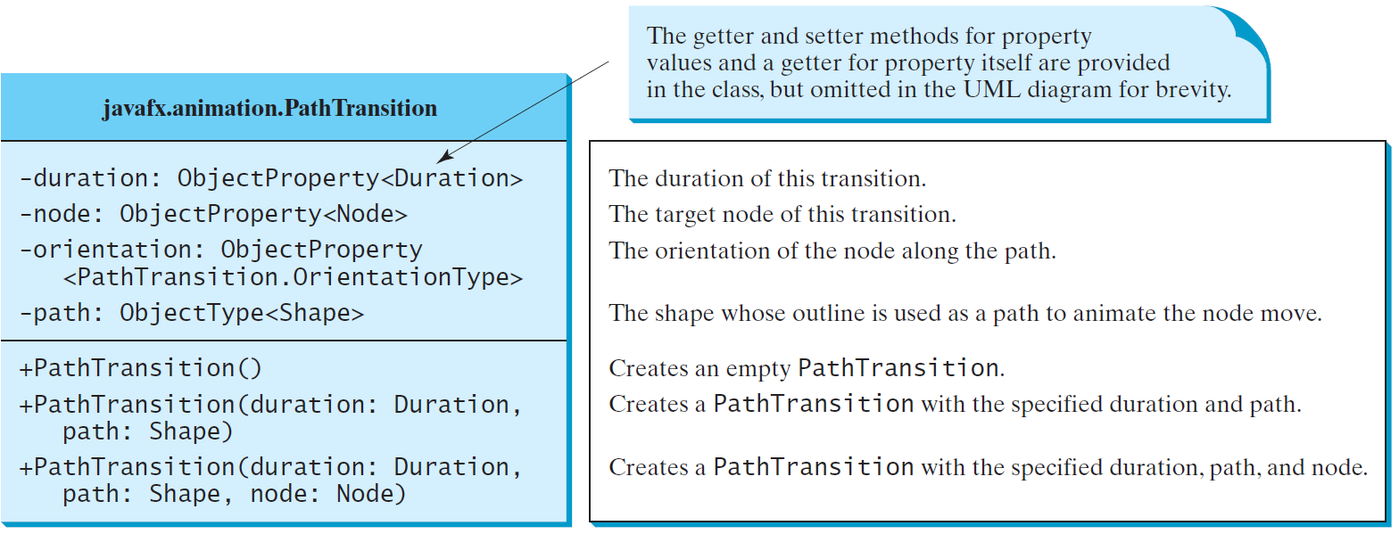
PathTransition
The PathTransition class animates the moves of a node along a path from one end to the other over a given time.
PathTransitionDemo
Run
FlagRisingAnimation
Run
Notes:
First, show the codes for FlagRisingAnimation on Eclipse IDE and run it.
Secondly, show the codes for PathTransitionDemo on Eclipse IDE and run it.

Slide 60
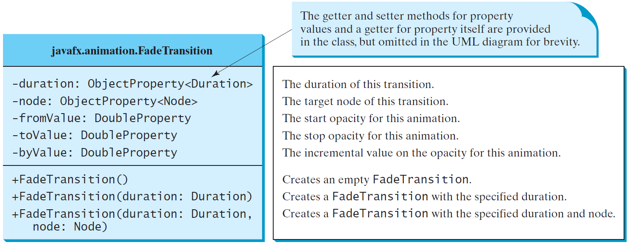
FadeTransition
The FadeTransition class animates the change of the opacity in a node over a given time.
FadeTransitionDemo
Run
Notes:
- Show the codes for FadeTransitonDemo on Eclipse IDE and run it.

Slide 61
Timeline
PathTransition and FadeTransition define specialized animations.
The Timeline class can be used to program any animation using one or more KeyFrames.
KeyFrame defines target values at a specified point in time for a set of variables that are interpolated along a Timeline.
Each KeyFrame is executed sequentially at a specified time interval.
Timeline inherits from Animation.
You can construct a Timeline using the constructor . new Timeline(KeyFrame... keyframes).
A KeyFrame can be constructed using new KeyFrame(Duration duration, EventHandler<ActionEvent> onFinished)
The handler onFinished is called when the duration for the key frame is elapsed.
TimelineDemo
Run
Notes:
- Show the codes for TimelineDemo on Eclipse IDE and run it.

Slide 62
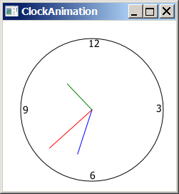
Clock Animation
ClockAnimation
Run

Slide 63
import javafx.application.Application;
import javafx.stage.Stage;
import javafx.animation.KeyFrame;
import javafx.animation.Timeline;
import javafx.event.ActionEvent;
import javafx.event.EventHandler;
import javafx.scene.Scene;
import javafx.util.Duration;
public class ClockAnimation extends Application {
@Override // Override the start method in the Application class
public void start(Stage primaryStage) {
ClockPane clock = new ClockPane(); // Create a clock
// Create a handler for animation
EventHandler<ActionEvent> eventHandler = e -> {
clock.setCurrentTime(); // Set a new clock time
};
// Create an animation for a running clock
Timeline animation = new Timeline(
new KeyFrame(Duration.millis(1000), eventHandler));
animation.setCycleCount(Timeline.INDEFINITE);
animation.play(); // Start animation
// Create a scene and place it in the stage
Scene scene = new Scene(clock, 250, 250);
primaryStage.setTitle("ClockAnimation"); // Set the stage title
primaryStage.setScene(scene); // Place the scene in the stage
primaryStage.show(); // Display the stage
}
public static void main(String[] args) {
launch(args);
}
}

Slide 64
☑ Check Point
How do you set the cycle count of an animation to infinite? How do you auto reverse an animation? How do you start, pause, and stop an animation?
<--- ANSWER --->
animation.setCycleCount(Timeline.INFINITY);
animation.setAutoReverse(true);
animation.start();
animation.pause();
animation.stop();

Slide 65
☑ Check Point
How do you create a KeyFrame?
<--- ANSWER --->
To create a KeyFrame, use new KeyFrame(Duration, handler).

Slide 66
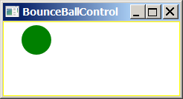
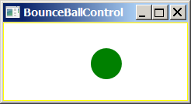
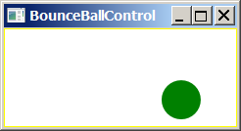
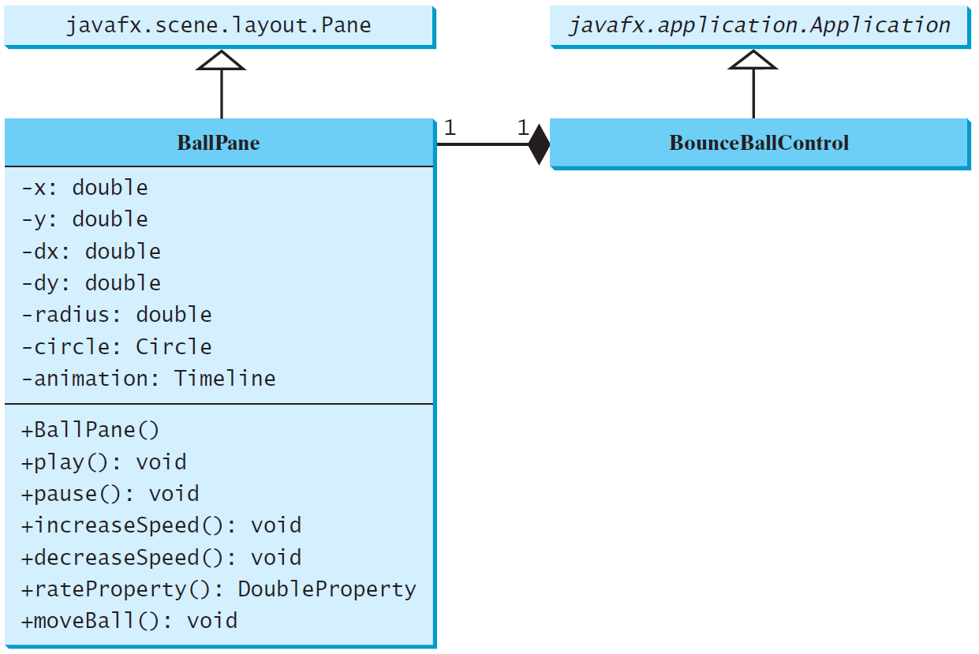
Case Study: Bouncing Ball
BallPane
BounceBallControl
Run

